Slide 1

Home Credit Default Risk
Team 1
Che Diaz Fadel, Kalyani Joshi, Roman Brock, Chris Porter

Slide 2

About Home Credit Risk
Non-bank finance provider
Lend loans
Financial inclusion
Diverse applicants
Positive and safe borrowing experience

Slide 3

Objective of Home Credit
Reach out to credit-invisible population
Help achieve financial goals
Client data from various sources
Build ML model
Assess repayment abilities

Slide 4
Business Problems and Risks
Customers have insufficient or non-existent credit histories
Available data is inconsistent and non-traditional
The majority class accounts for over 90% of the population
Knowledge of available data is limited

Slide 5
Project Scope
Analyze and explore available data
Build a Classification Model to predict default; balance inclusivity with prudent risk assessment
Deliverables
Professional notebook containing data analysis and trained model
Presentation w/ findings and recommendation

Slide 6
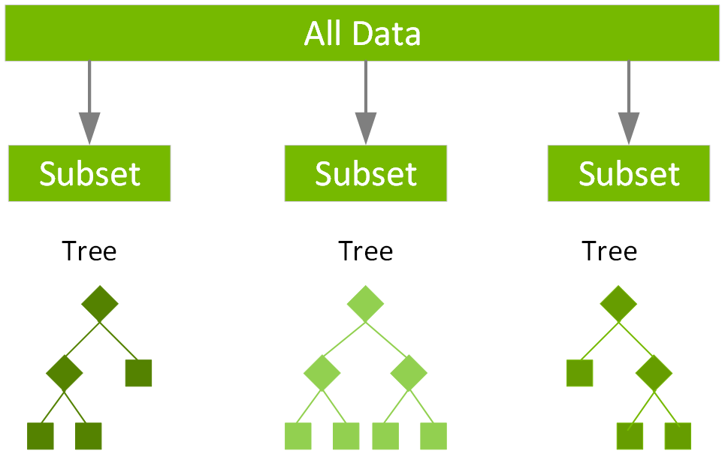
Best Model
Extreme Gradient Boosting (XGBoost) was the best performing model.
19 Features*
7 Tuned Hyperparameters*
5-fold Cross Validation
50 iterations
*See Appendices for Details

Slide 7
Model Performance
The primary goal of our model is to reduce Defaults classified as No Default (Type II Errors)
Prediction using only Majority Class
 | Actual No Default | Actual Default
Predicted No Default | 72829 | 6147
Predicted Default | 0 | 0
(values shown are from validation set)
Notes:
Actual Defaults predicted as No Default are most costly
Loss of Principal and potential earnings on interest.
Prefer to truly predict Default
Willing to accept some erroneous Default as less costly (interest only)

Slide 8
Model Performance
The primary goal of our model is to reduce Defaults classified as No Default (Type II Errors)
Prediction using XGBoost Model
 | Actual No Default | Actual Default
Predicted No Default | 66801 | 4946
Predicted Default | 6028 | 1201
Kaggle Score: 0.5563
Notes:
16.38% Decrease in number of Predicted No Defaults that will actually default

Slide 9
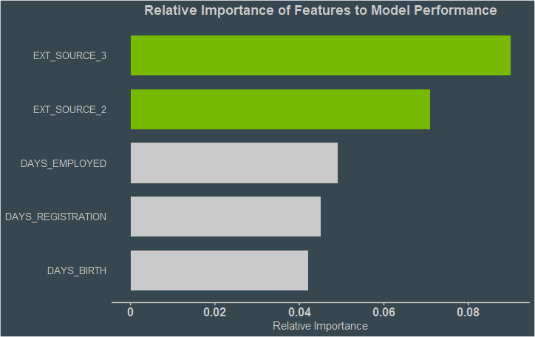
Most Predictive Features
External data source is highly valuable
Basic, time-oriented metrics drive impact

Slide 10
Recommendations
Pursue further metrics/insights from external data source
Further develop model, then integrate into automated onboarding/underwriting systems
Business Value
19.5%reduction of average lending risk
~$37,700 average avoided loss per client
Expedited acquisition with reduced overhead

Slide 11


Slide 12
Appendix

Slide 13
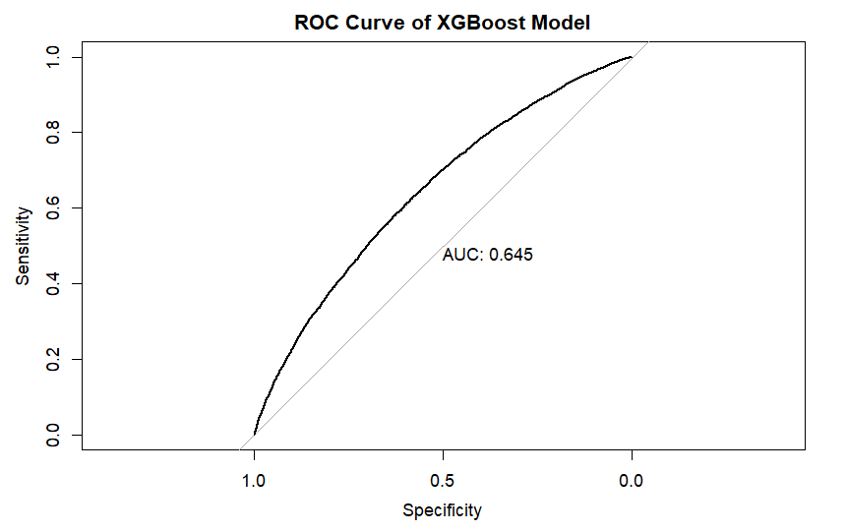
Appendix 1 ROC Curve

Slide 14
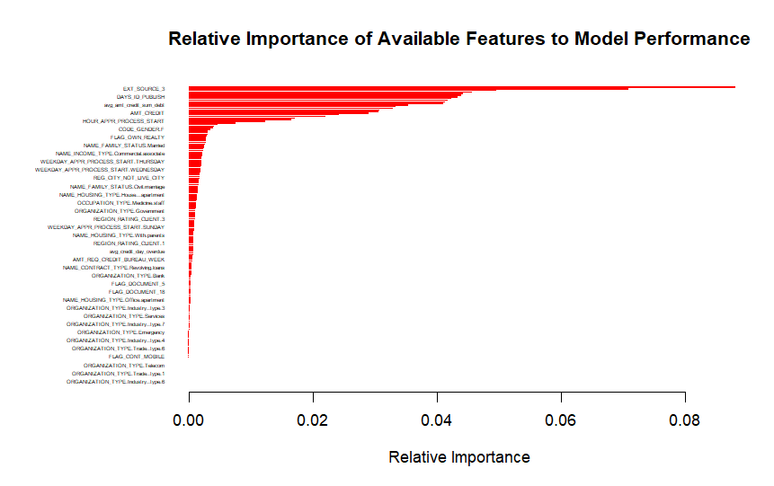
Appendix 2 Relative Importance of All Variables

Slide 15
Appendix 3 Variables Included in Final Model
EXT_SOURCE_3
EXT_SOURCE_2
DAYS_EMPLOYED
DAYS_REGISTRATION
DAYS_BIRTH
DAYS_ID_PUBLISH
Avg_days_credit_enddate
Avg_amt_credit_sum
Avg_days_credit
AMT_ANNUITY
Avg_amt_credit_sum_debt
DAYS_LAST_PHONE_CHANGE
APARTMENTS_AVG
AVG_EXT_SCORE
EXT_SOURCE_1
AMT_CREDIT
Avg_amt_credit_max_overdue
AMT_INCOME_TOTAL
AMT_GOODS_PRICE

Slide 16
Appendix 4 Tuned Hyperparameters
Tuning Grid
max_depth = 3 ≥ x ≥ 9
nrounds = 200 ≥ x ≥ 500
min_child_weight = 5 ≥ x ≥ 10
subsample = 0.5 ≥ x ≥ 1
Gamma = 0 ≥ x ≥ 5
colsample_bytree = 0.7 ≥ x ≥ 1
eta = 0.01 ≥ x ≥ 1
Selected Hyperparameters
max_depth = 8
nrounds = 460
min_child_weight = 6.356507
subsample = 0.5333193
gamma = 2.946654
colsample_bytree = 0.8473639
eta = 0.9114226

Slide 17
Home Credit Current Branding

